Slide 1






Semester project on
Wedding Planning
Team Name: BiuBiuBiu
Teacher:
Rahul Dtalreja
Date:
2017-6-24

Slide 2


Development Team
Development Team
Development Team
Jerry(Team Leader)
Anastasia
Aimee
Annie

Slide 3

Anastasia
Aimee
Team
Wedding Class
Feedback
Home Page
About
Footer
Jerry
Annie
Login In
Register
Reserve
PPT
Gallery
Plan
Header

Slide 4
02
Home Plan Gallery
Project Overview
Reserve
Wedding Class
Team About
Login Register

Slide 5
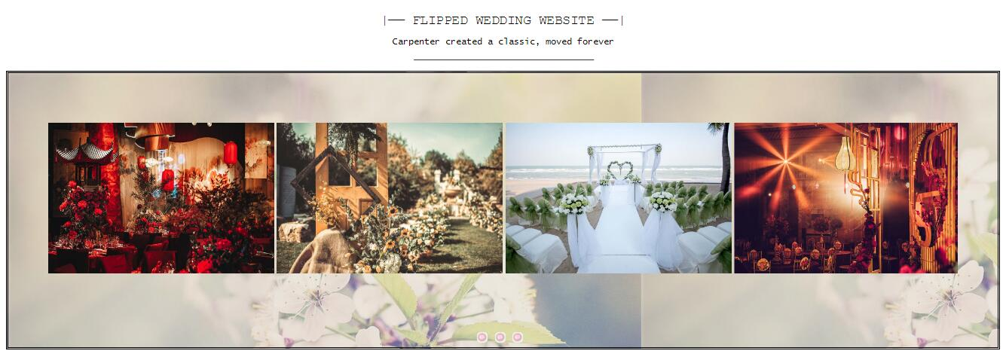
Home

Slide 6
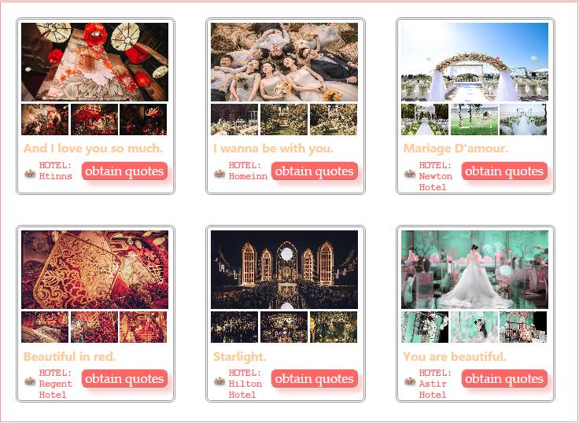
Home

Slide 7
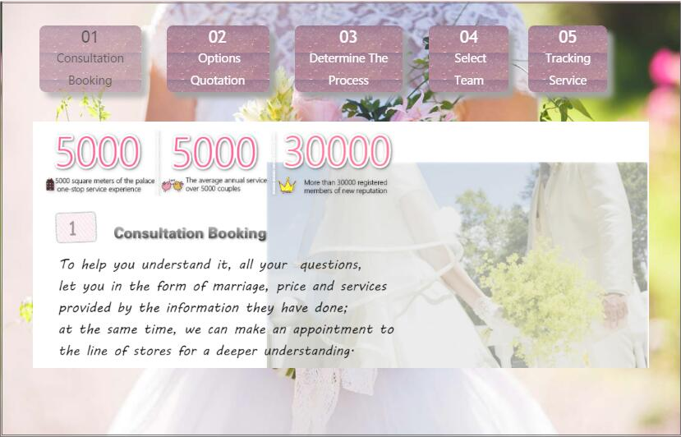
Home

Slide 8
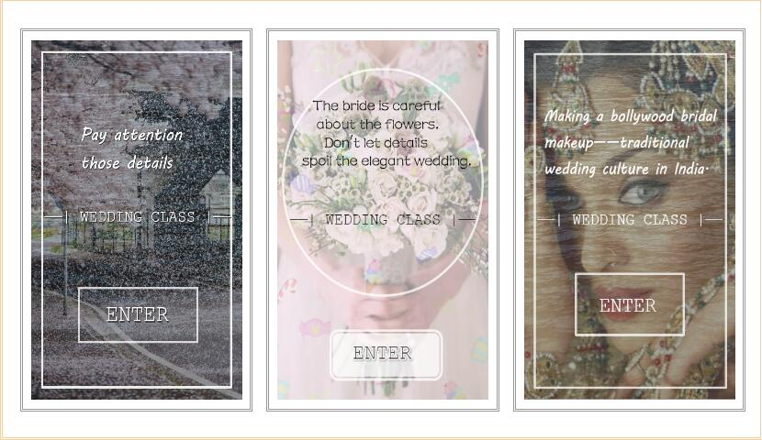
Home

Slide 9
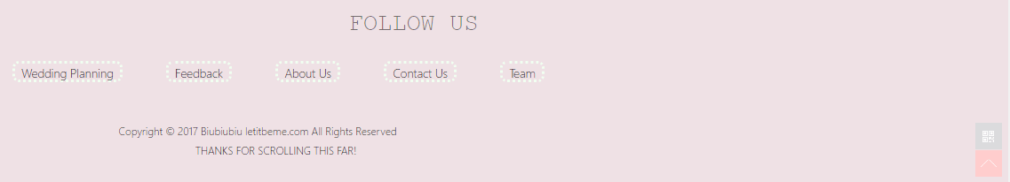
Home

Slide 10
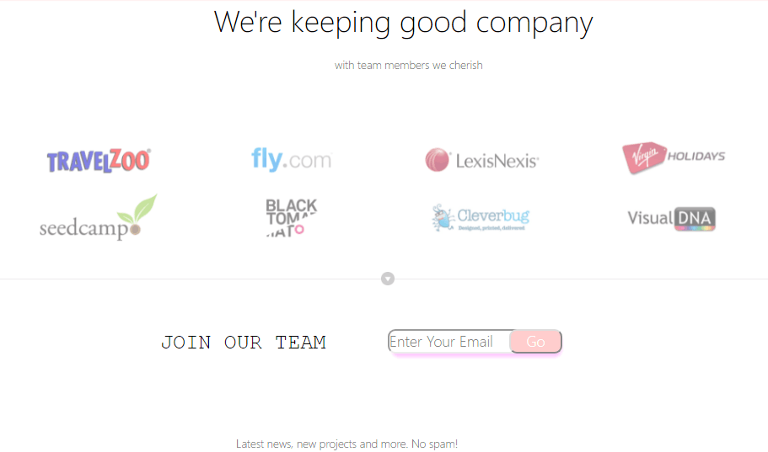

Join US

Slide 11
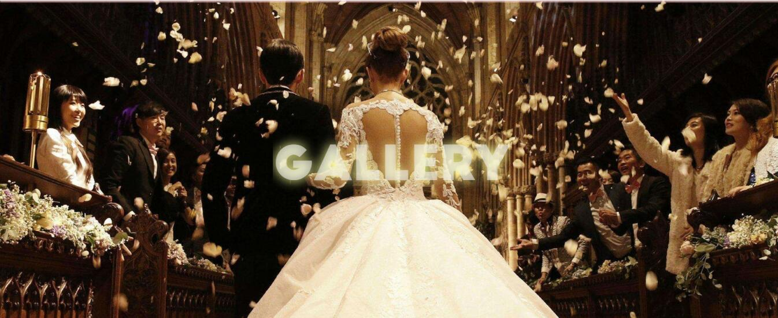
Gallery

Slide 12
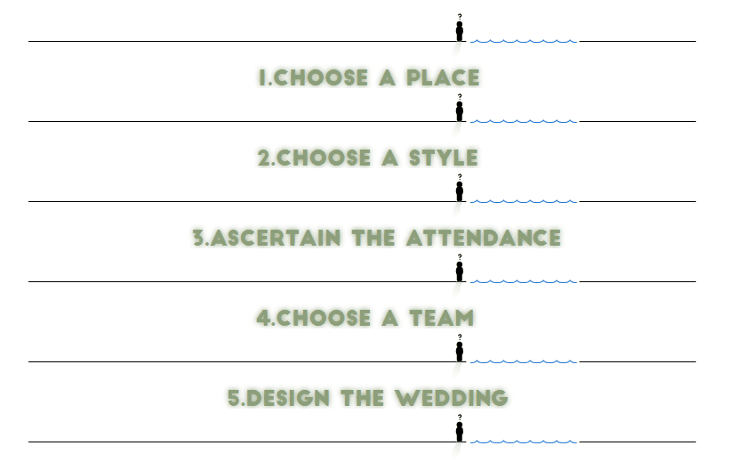
Plan

Slide 13
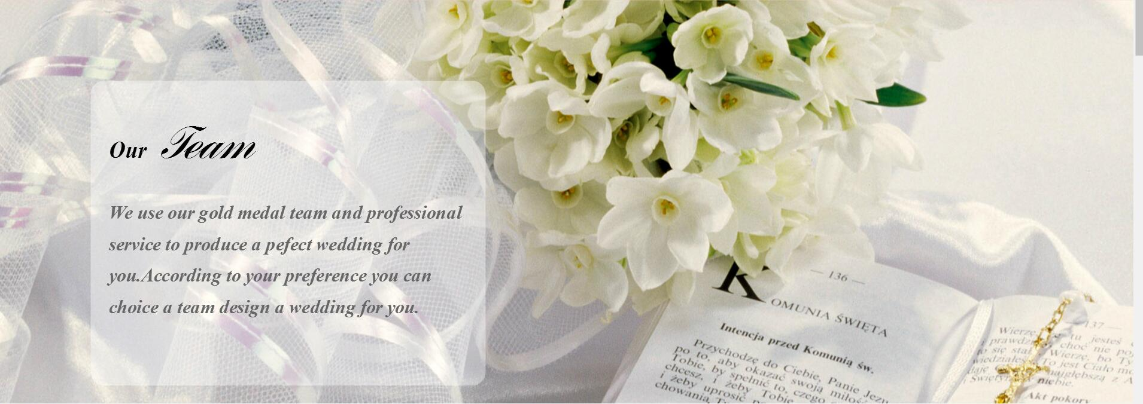
tEAM

Slide 14
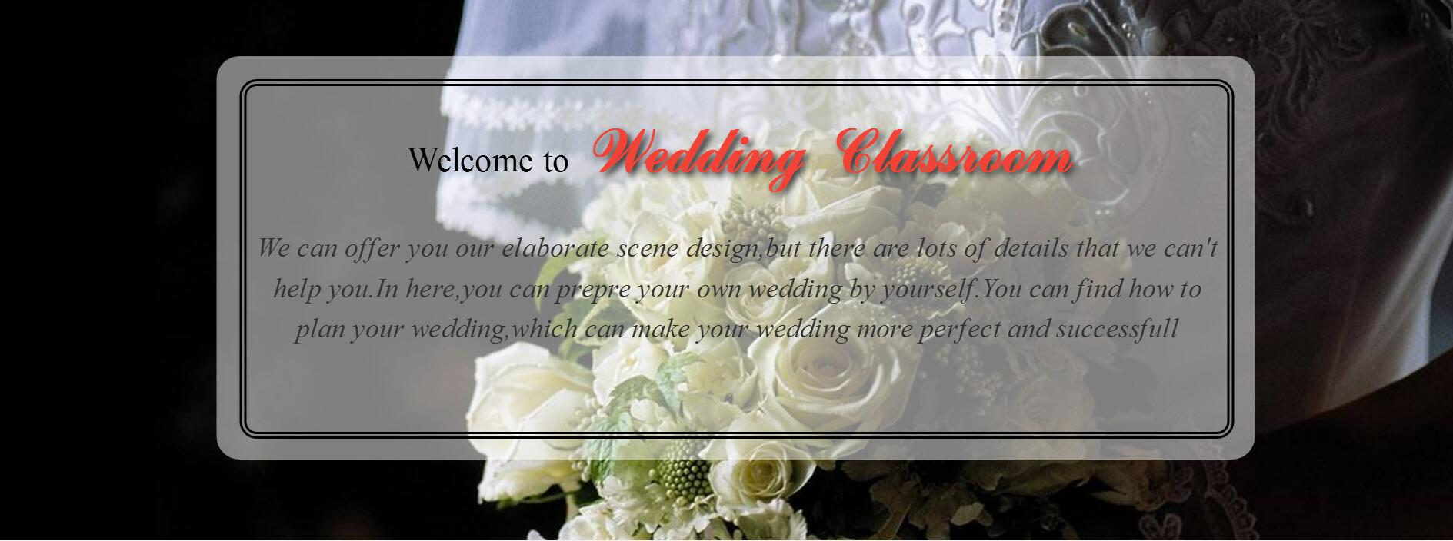
Weeding CLASS

Slide 15
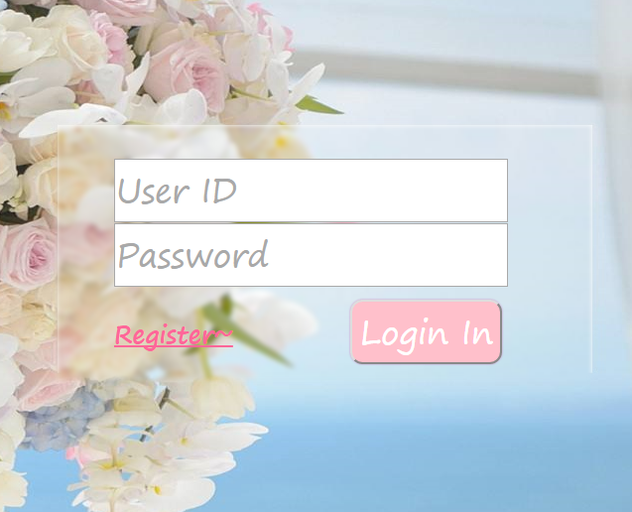
Login

Slide 16
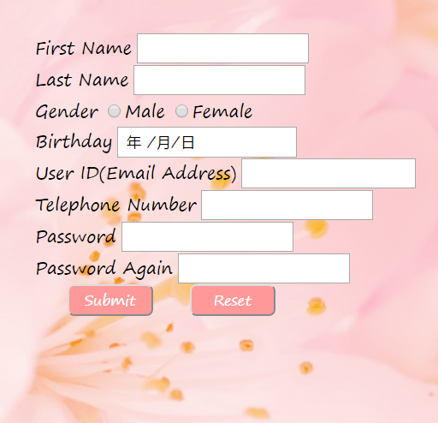
REGISTER

Slide 17
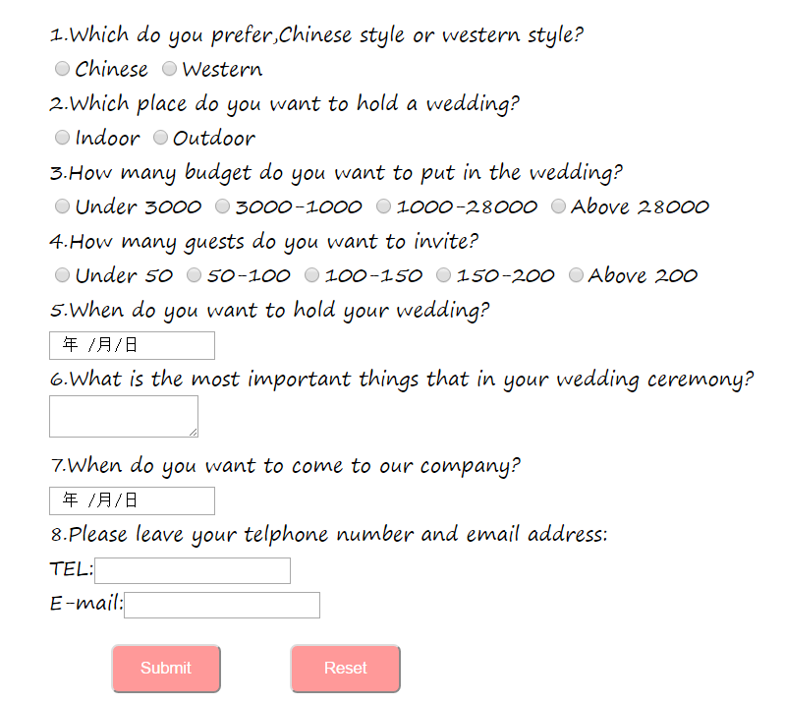
reserve

Slide 18

03
HTML 5
Technical skills used during the project
Java Script
CSS
Photoshop
Premiere

Slide 19
04
Problems Faced during the Development
We become much better after the semester project

Slide 20
How to control the play of music with keyboard.
How to make word slide on the photo.
Jerry
How to realize button ID match the specified value(Phone Number).
Anastasia
How to show perfectly in service flow.
How to save the email address in joinus.html.
Aimee
How to test the functions.
How to balance the different functions.
Annie

Slide 21
05
We have many creative ideas.
Such as…
Main Functions
We can use this website to plan your dream wedding.

Slide 22
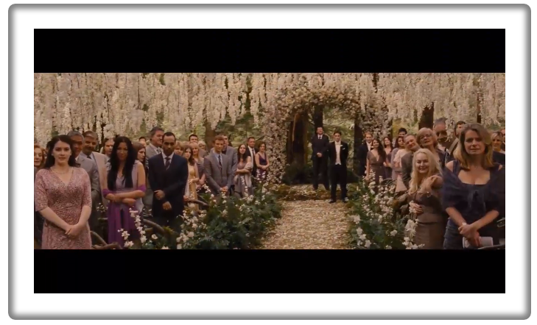
A video cut by Jerry

Slide 23
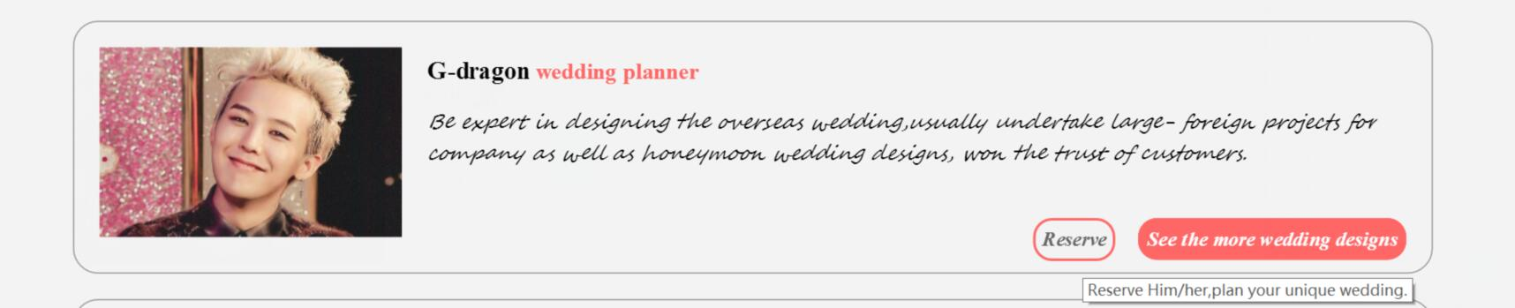
You can reserve your own designer

Slide 24
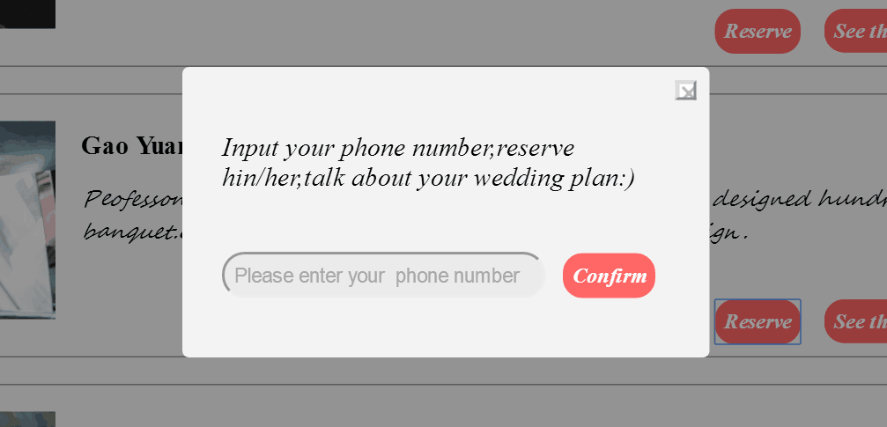
You can reserve your own designer

Slide 25
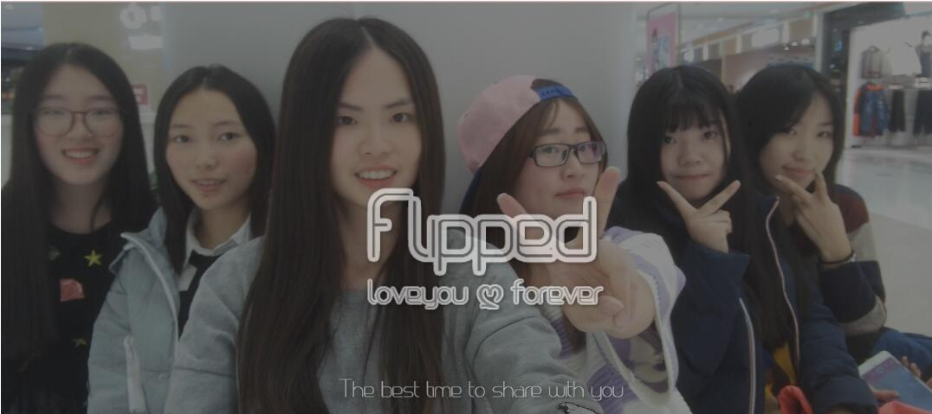
Our team is energetic

Slide 26
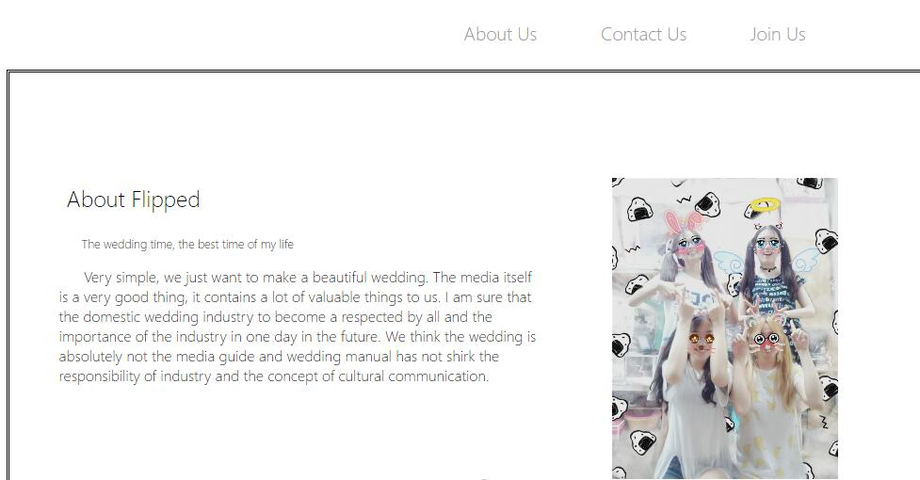
Our team is energetic

Slide 27
06
How to control the layout.
How to make the word’s CSS more beautiful.
Learning achieved during
Project Development
Jerry
Deal with the conflict of different functions.
Annie
How to use div to locate better.
Anastasia
How to prepare myself wedding.
How to design a website more beautiful.
Use CSS to do anything you want.
Aimee

Slide 28
07
Although we have made the webpage, we still think we can make it more perfect. We aim to give client a wonderful and unforgettable wedding. When you see our webpage, you want to have a wedding. Therefore, we want to implement ore function. For example, when client finishes her reservation, we will recommend her our wedding theme which is based on her reservation. Besides, we can make our webpage more beautiful and attractive to make clients choose us to plan a wedding for them.
Future Vision/idea on the Project

Slide 29
THANK YOU
From BiuBiuBiu

